Slide 1
Smart save drives
Presented By Team 7:
Pamarthi vamshi-23CSE3019
Gundu Prajith-23CSE3037
Kesani chandrahas Reddy 23CSE3048
Rapol Srujith Reddy-23CSE3051
Ancha Rishi –23CSE3053
Guidence By
Mahesh Babu

Slide 2
Abstract
Road traffic accidents are a major global issue mainly caused by human errors
Common causes include distraction, fatigue, overspeeding, and delayed reactions
Safe Smart Drive is a technology-driven system to improve road safety
Integrates Artificial Intelligence (AI), Internet of Things (IoT), and cloud computing
AI monitors driver behavior and predicts potential road hazards
IoT enables real-time vehicle-to-vehicle and vehicle-to-infrastructure communication
Cloud computing supports data analytics, traffic management, and emergency response

Slide 3

Problem Definition
Road accidents are increasing rapidly across the world
Accidents cause high loss of life and serious injuries
Human errors contribute to most road crashes
Common errors include distraction, fatigue, and overspeeding
Existing safety systems respond only after accidents occur
Traditional methods lack real-time monitoring capabilities
There is no effective prediction of road hazards
An intelligent system is required to assist drivers continuously

Slide 4

Literature Survey Summary
Several safety systems like ADAS are already used in modern vehicles
Collision warning systems help reduce impact severity
Speed monitoring systems assist in controlling overspeeding
Studies show AI is effective in detecting driver fatigue
AI techniques also identify driver distraction accurately
IoT enables vehicle-to-vehicle communication
IoT supports vehicle-to-infrastructure data exchange

Slide 5
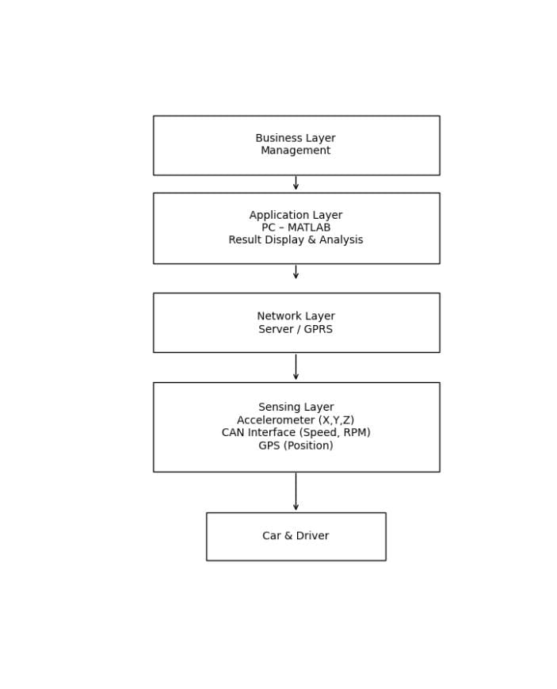
System Architecture:
Block Diagram
Components – Defines the major parts of the system (hardware, software, databases, services).
Layered Structure – Separates the system into layers like presentation, business logic, and data for clarity and maintenance.
Data Flow – Shows how data moves between components and how it is processed.
Communication – Specifies how components interact (APIs, protocols, interfaces).
Scalability & Security – Designed to handle growth, performance needs, and protect data from unauthorized access.

Slide 6
Module-wise plan
Driver Monitoring Module captures driver facial and eye movements
Detects drowsiness, distraction, and unsafe driving behavior
Collision Detection Module identifies obstacles in real time
Predicts collision risks using sensor data
Speed Monitoring Module tracks vehicle speed continuously
Generates alerts for overspeeding situations
Communication Module exchanges real-time data using IoT
Cloud Analytics Module analyzes traffic data and generates reports

Slide 7

Tools required
Python is used for system development and integration
OpenCV is used for image and video processing
TensorFlow is used for AI model development
Camera is used for driver monitoring
Sensors are used for speed and obstacle detection
GPS module provides location tracking
Arduino or Raspberry Pi is used for IoT control
AWS or Firebase is used for cloud storage and analytics

Slide 8
Conclusion.
Smart Safe Drives play a crucial role in improving road safety by reducing human errors through intelligent technology. They help prevent accidents, save lives, and promote efficient and eco-friendly driving. While these systems offer significant advantages, they are not flawless and depend on proper usage, maintenance, and supporting infrastructure. Smart Safe Drives should be viewed as assistive tools, not replacements for responsible driving. Real road safety comes from combining technology with disciplined driver behavior and strong traffic regulations.

Slide 9

Thank You

